Slide 1
Computer Network
From Bits to Bandwidth

Slide 2
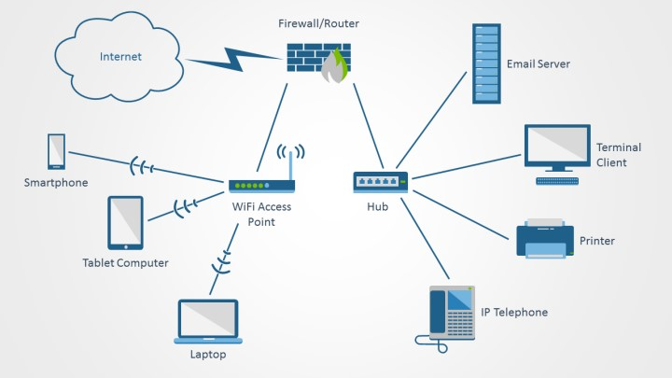
Your First Thought on Computer Network

Slide 3
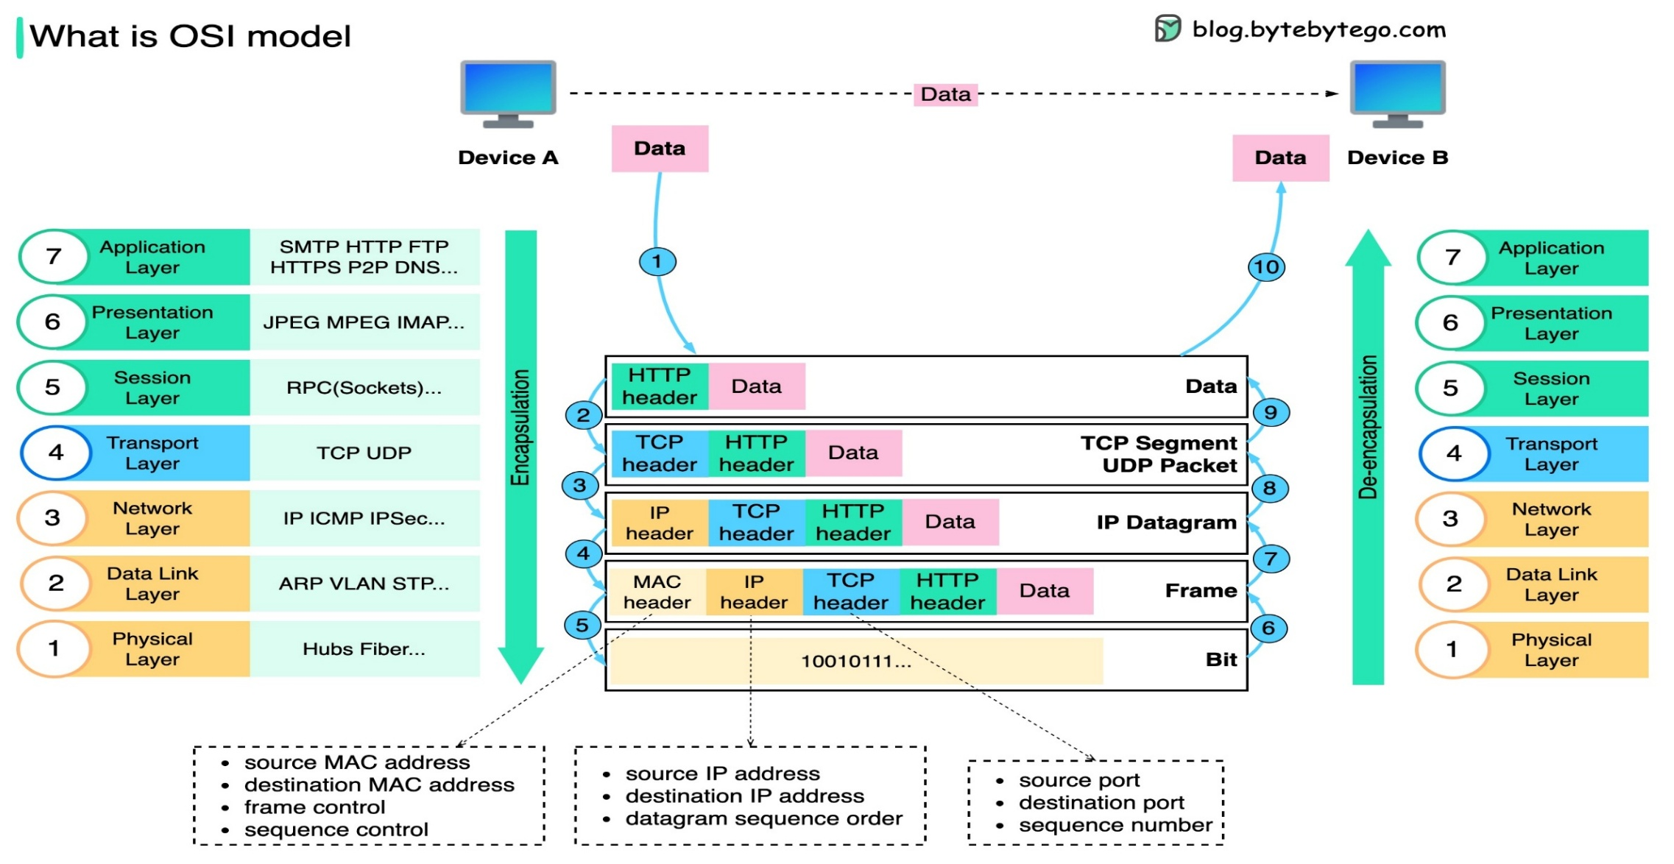
How it actually looks…

Slide 4
What We’ll Talk About
IP Address
Error Control
Flow Control
IPv4 Header
Transport Layer
Medium Access control
Routing, Switching, IP Support Protocol
Application Layer

Slide 5
IP Address

Slide 6
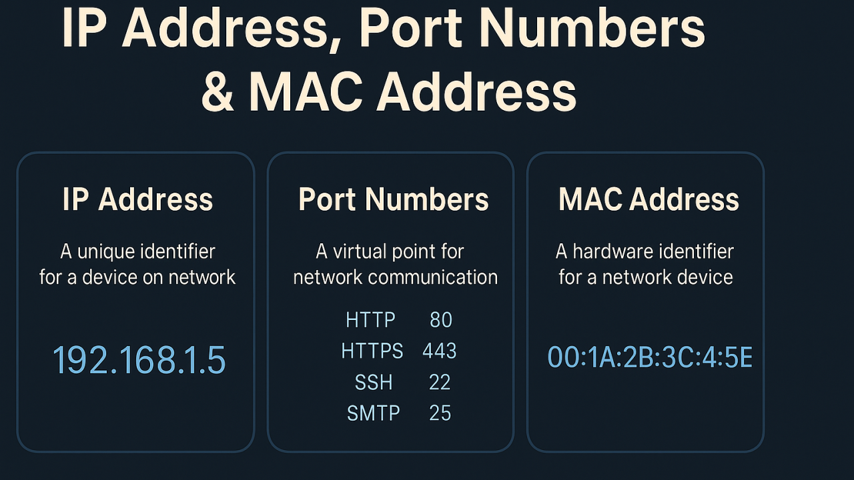
Does an Address Belong to a Device, Network, or Process?

Slide 7
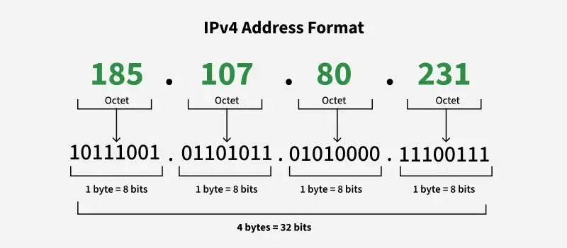
What’s an IPv4 Address?

Slide 8
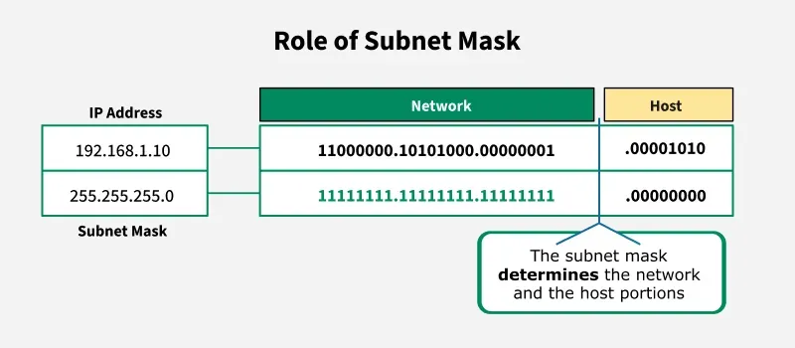
What’s Subnet Mask?

Slide 9
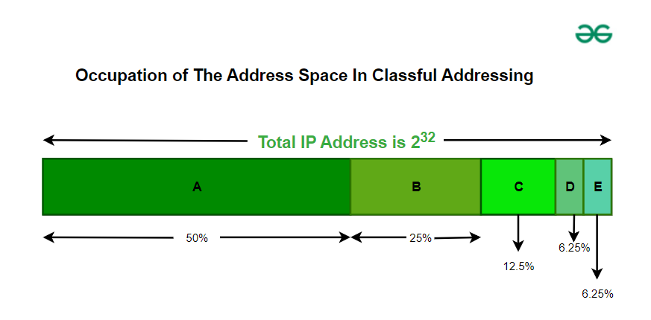
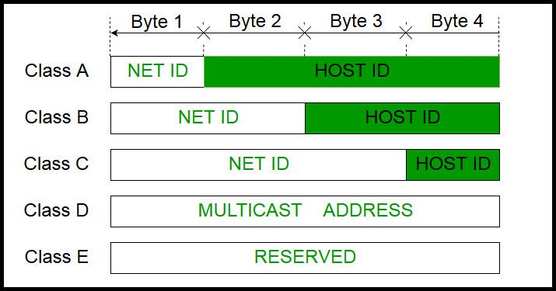
What’s Classful Addressing?

Slide 10
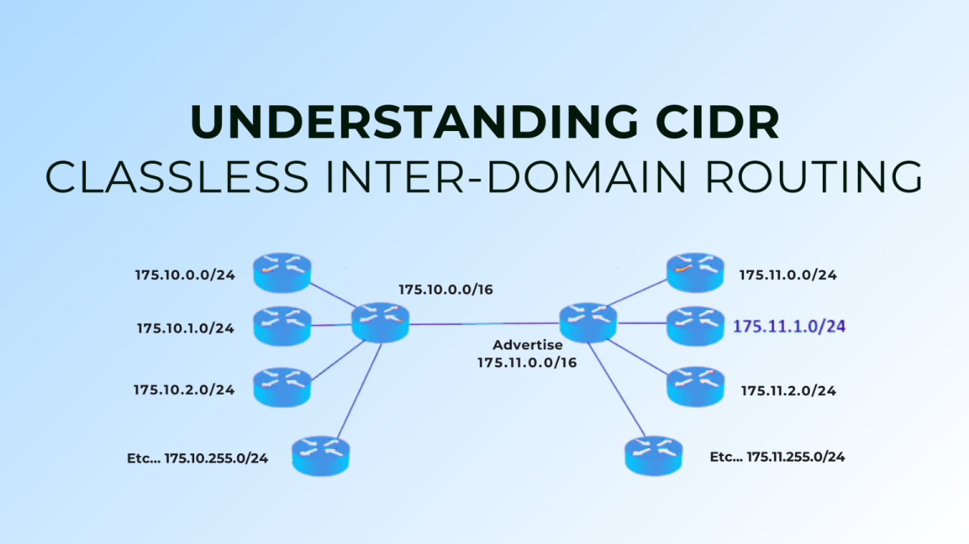
What’s Classless Addressing?
All IPs must be contiguous.
Block size must be a power of 2 (2ⁿ) simplifies network division.
First IP of block divisible by block size least significant bits of host ID should be 0.

Slide 11
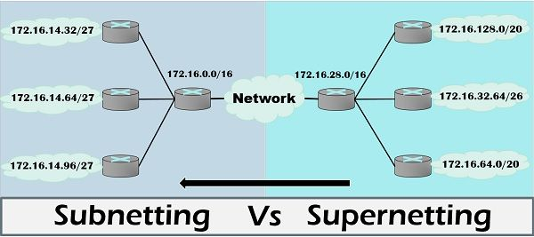
Subnetting vs Supernetting

Slide 12

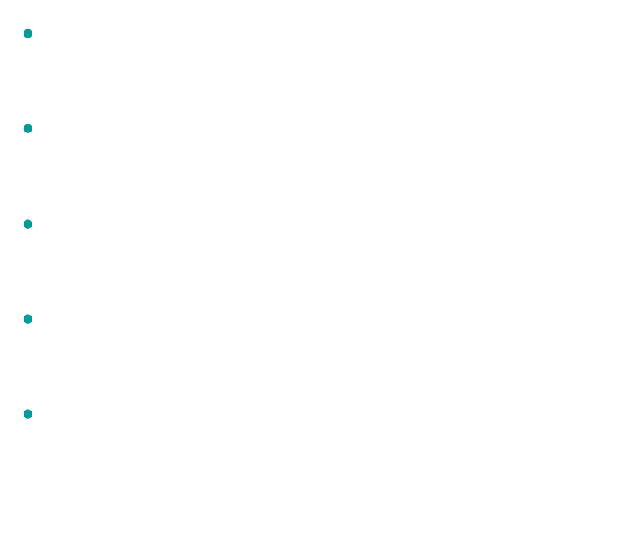
IPv6 Addressing
Designed to replace IPv4 due to IPv4 address exhaustion.
Uses 128-bit addresses → supports $\sim 3.4×10³⁸$unique addresses.
It simplifies packet headers, making routing faster and more efficient.
Security is built in with mandatory support for IPsec.
It enables direct device connectivity with auto-configuration and better mobility support.

Slide 13
Error Control

Slide 14
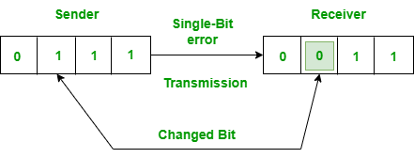
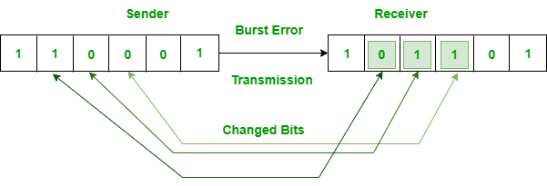
What Errors Can Occur in a Network?

Slide 15
What’s Error Control
Error Control
Error Detection
Error Correction

Slide 16
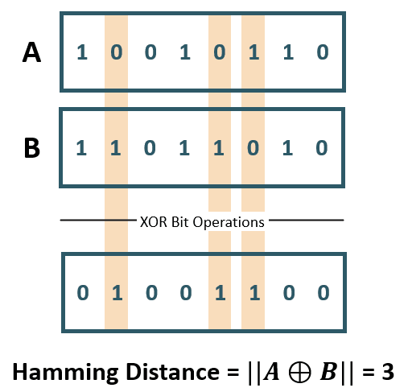
What’s Hamming Distance
Minimum Hamming Distance rules:
Detect up to d errors: Minimum distance ≥ d + 1
Correct up to d errors: Minimum distance ≥ 2d + 1

Slide 17
What are Error Control Methods
For Detection:
Simple & 2D Parity
Cyclic Redundancy Code
Checksum
For Correction
Hamming Code

Slide 18
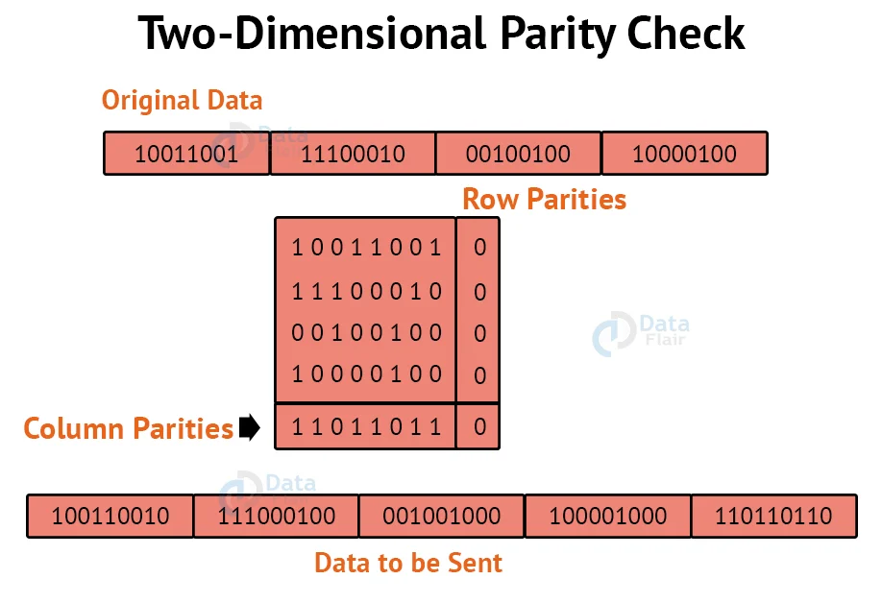
Simple & 2D Parity

Slide 19
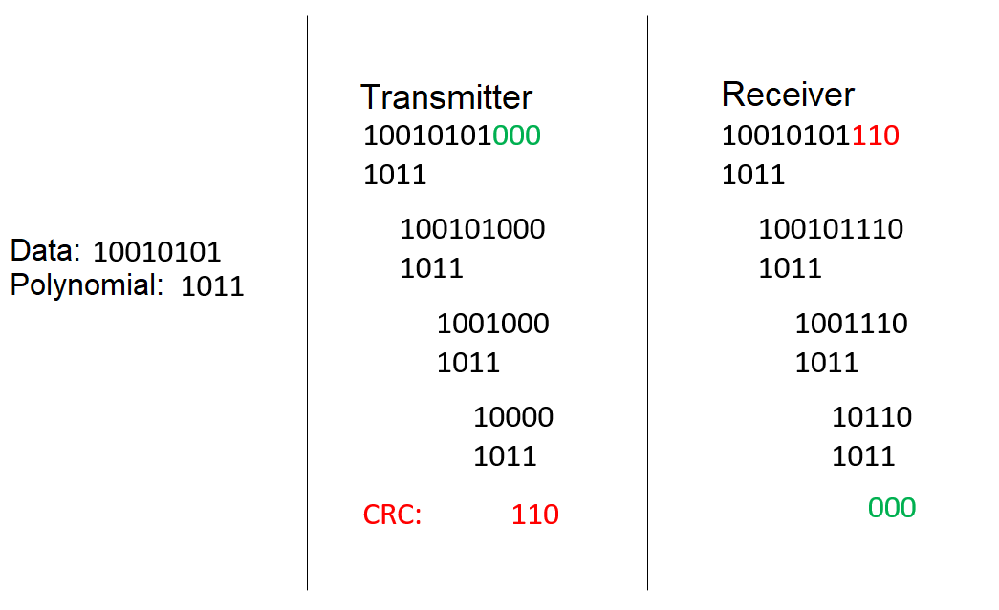
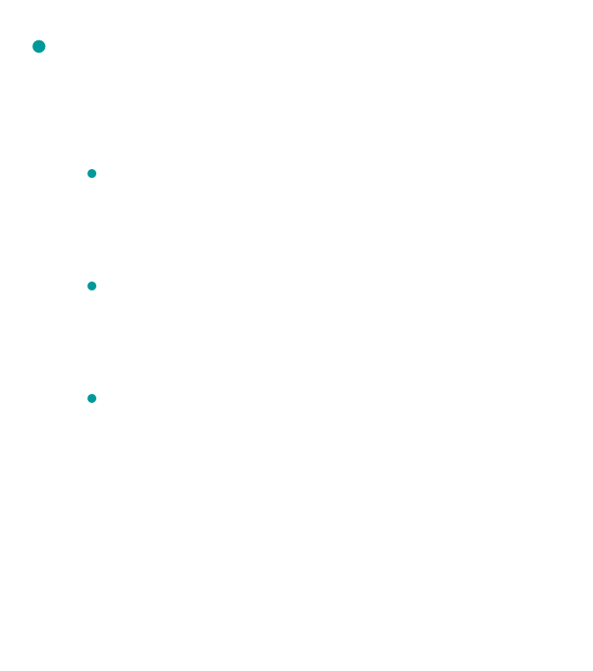
Cyclic Redundancy Code
Good CRC Generator Polynomial
Must have more than one nonzero term.
Must not divide $x^{n}+1$ for any n.
Must have a factor of $x+1$.

Slide 20
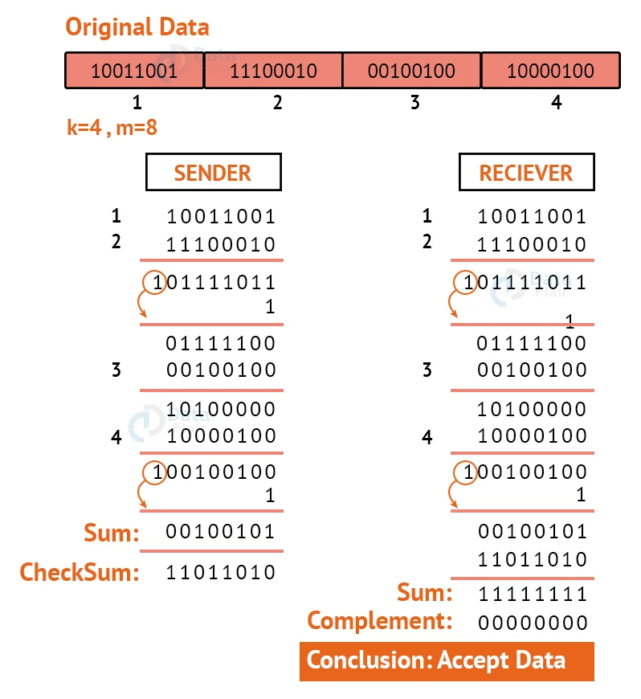
Checksum
Checksum can fail if errors cancel each other out, this is why CRC is preferred for critical data.

Slide 21
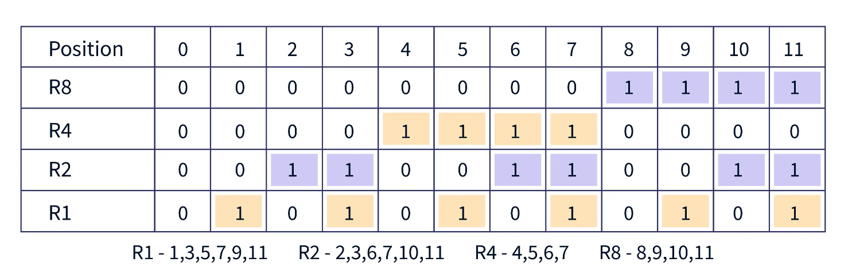
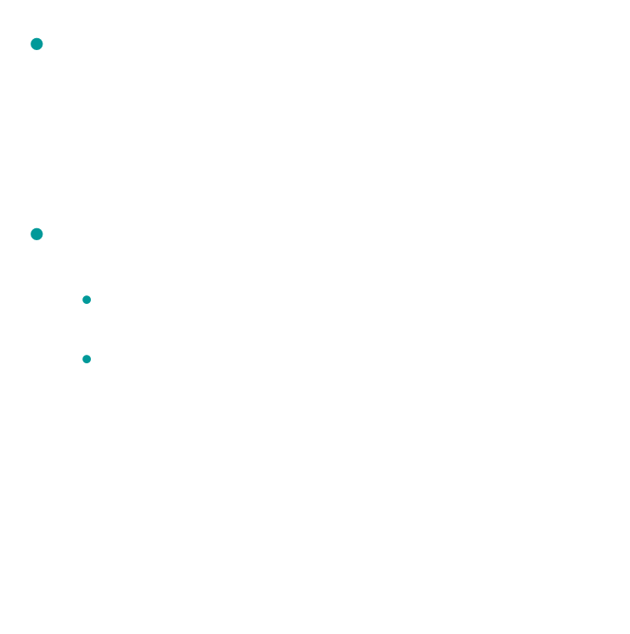
Hamming Code
Uses parity bits placed at positions that are powers of 2 (1, 2, 4, 8…).
$m + r + 1 ≤ 2^{r}$
m = number of data bits
r = number of parity bits

Slide 22
At a Glance
Method | Detects Errors | Corrects Errors | Notes / Comments
Parity Bit | 1-bit (single-bit errors) | ❌ None | Can detect odd number of errors, simple and fast
Checksum | Single-bit + some multiple-bit errors | ❌ None | Simple sum of data words, less reliable than CRC
CRC | All single-bit, most multi-bit, burst errors ≤ CRC length | ❌ None | Very reliable, used in network protocols
Hamming Code | All single-bit errors | 1-bit | Can detect and correct 1-bit errors, uses parity bits

Slide 23
Flow Control

Slide 24
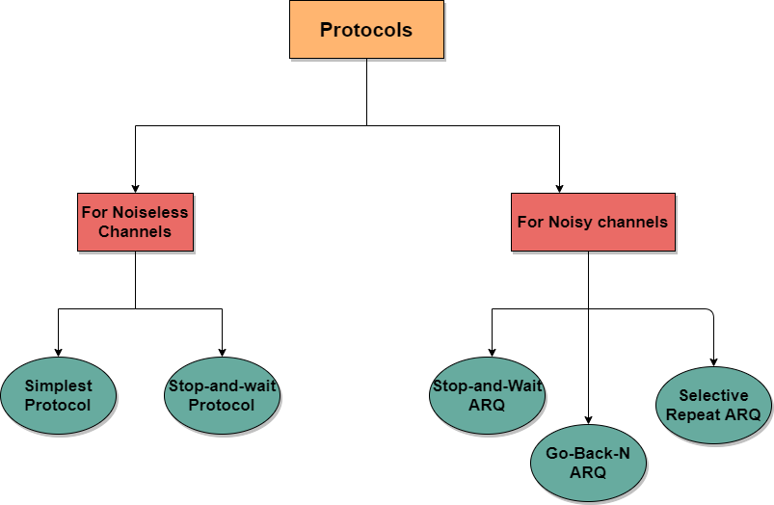
How Does a Network Control the Flow of Data?

Slide 25
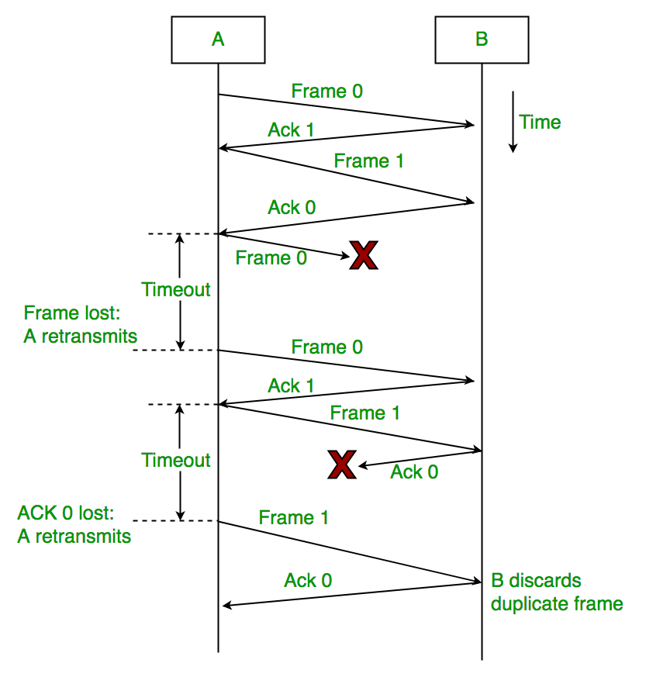
Stop-&-Wait ARQ

Slide 26
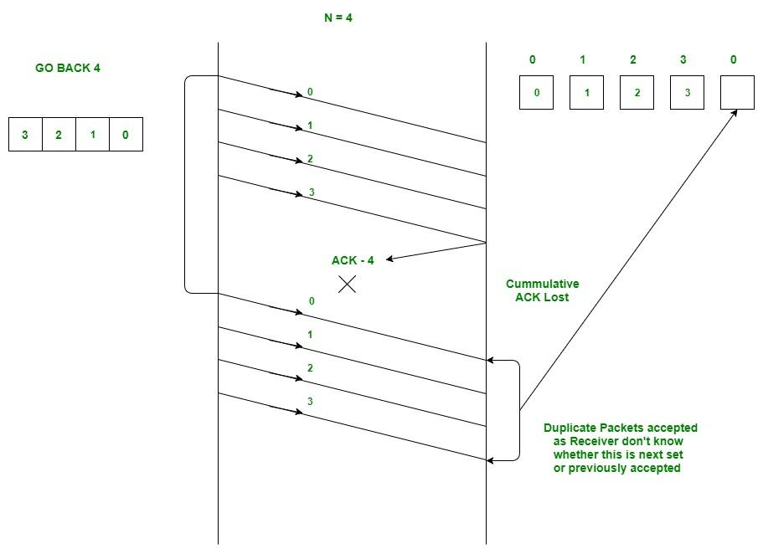
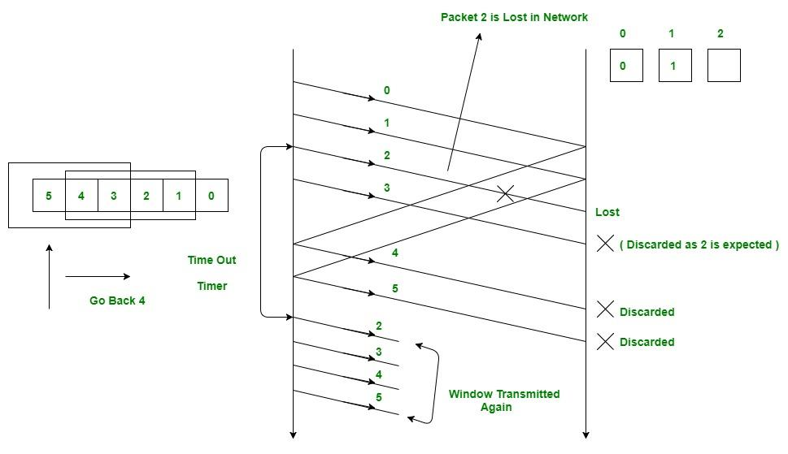
Go Back-N ARQ

Slide 27
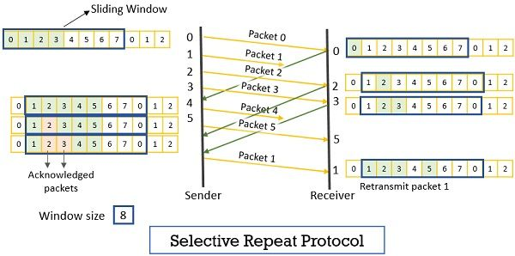
Selective Repeat ARQ

Slide 28
Comparison of ARQ(Automatic Repeat reQuest) Protocols
Feature | Stop-and-Wait | Go-Back-N (GBN) | Selective Repeat (SR)
Sender Window Size | 1 | N | N
Receiver Window Size | 1 | 1 | N
Sequence Numbers | 0,1 | 0 to N-1 | 0 to N-1
Acknowledgment | Individual | Cumulative | Individual
Retransmission | On timeout | On timeout of lost frame | Only lost frame
Efficiency | Low | Better than Stop-and-Wait | Highest
Buffer Requirement | Low | Moderate | High
Complexity | Simple | Moderate | Complex
Error Handling | Single frame | Multiple frames lost | Individual frames lost

Slide 29



Performance Analysis of ARQ Protocols
Parameter / Term | Meaning
$$T_{d−f}$$ | Transmission delay (time to send a frame)
$$P_{d}$$ | Propagation delay (time for signal to travel to receiver)
$$Q_{d}$$ | Queuing delay (time a frame waits in buffer)
$$PR_{d}$$ | Processing delay (time to process a frame at sender/receiver)
$$T_{d−ack}$$ | Time to transmit acknowledgment
$$RTT$$ | Round Trip Time = $T_{d−f}+{2∗P}_{d}+Q_{d}+{PR}_{d}+T_{d−ack}$
Protocol | Efficiency (η)
Stop-and-Wait | η = $\frac{T_{d}}{RTT}$
Go-Back-N (GBN) | η ≈ $\frac{{N ∗ T}_{d}}{RTT}$
Selective Repeat (SR) | η ≈ $\frac{{N ∗ T}_{d}}{RTT}$
Throughput($τ$) = Efficiency($η$) * Bandwidth

Slide 30
IPv4 Header

Slide 31
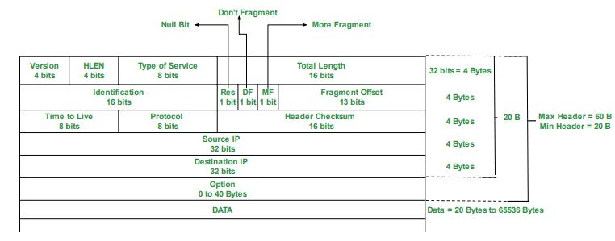
Let’s Have a Look at the IPv4 Header

Slide 32
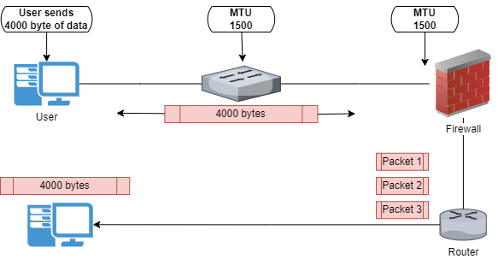
What's IPv4 Fragmentation

Slide 33
Facts About IPv4 Fields
HLEN is 4 bits, so maximum value it can store is 15. Header size ranges from 20 B to 60 B. This works because HLEN stores header length in units of 4 bytes. Actual header size = HLEN × 4 bytes
Total Length (TLEN) is 16 bits. Maximum packet size = 2¹⁶ − 1 = 65,535 bytes; Includes header + data
Fragment Offset is 13 bits, but does not count bytes directly. Offset is measured in 8-byte units. Actual fragment position = Fragment Offset × 8 bytes. This is why fragment size must be a multiple of 8 bytes
Why scaling factor = 8? Saves bits in header, Allows large packet offsets using fewer bits

Slide 34
Facts About IPv4 Fields
TTL is 8 bits. Maximum value = 255. Decremented by 1 at each router. Prevents packets from looping forever
Protocol field is 8 bits. Identifies the upper-layer protocol. Examples: TCP = 06, UDP = 17, ICMP = 01
Type of Service (ToS) is 8 bits. Originally for delay, throughput, reliability, priority. Now split into DSCP (6 bits) + ECN (2 bits). "DSCP tells routers how important a packet is, ECN tells endpoints how congested the network is."
Header Checksum covers header only. Recomputed at every hop because TTL changes.

Slide 35
Transport Layer

Slide 36
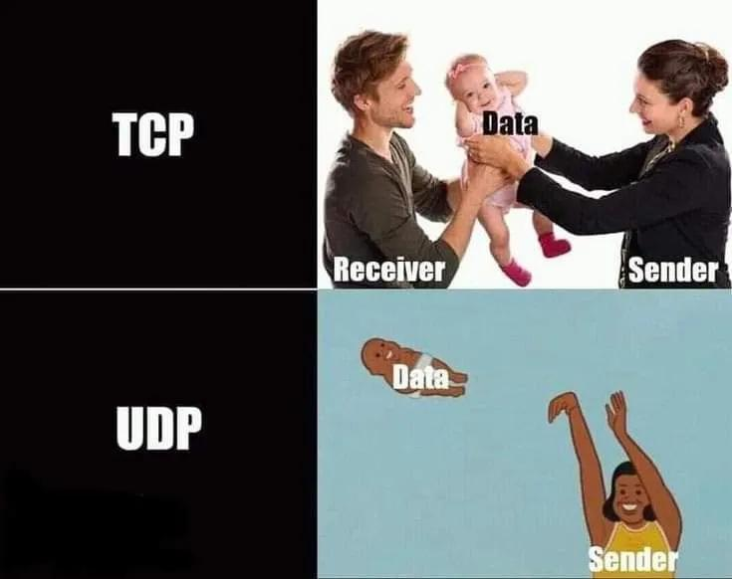
Let’s Move Towards the Transport Layer

Slide 37
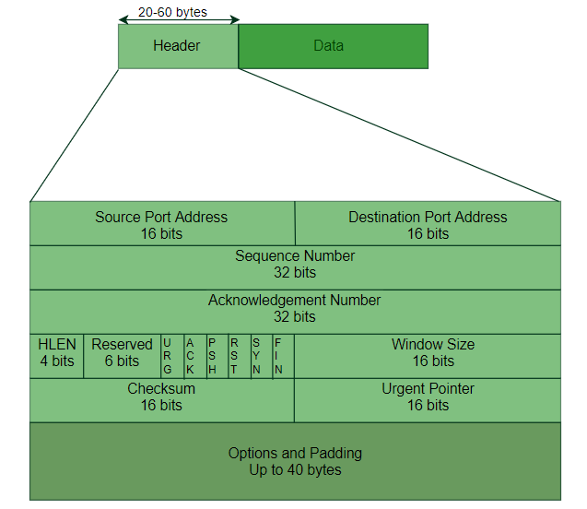
TCP Header

Slide 38
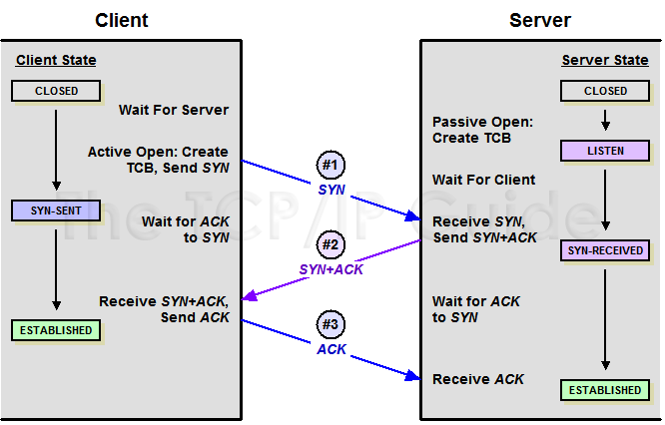
TCP 3-Way Handshake

Slide 39
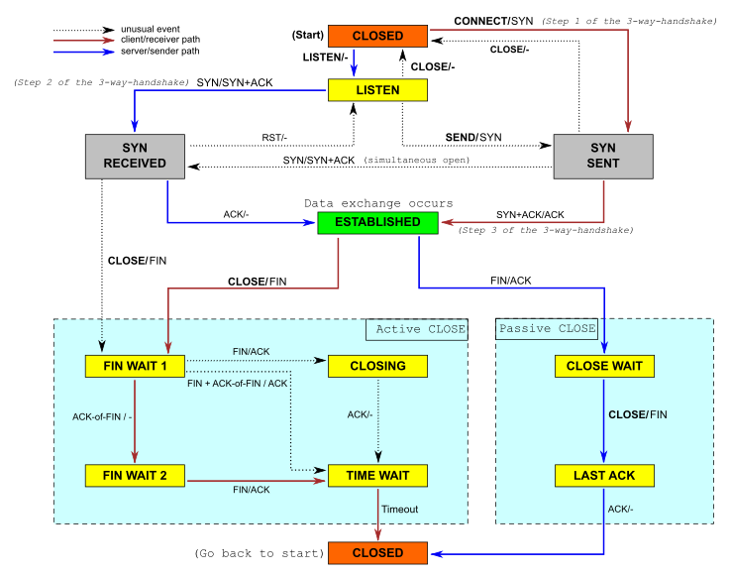
TCP State Transition

Slide 40
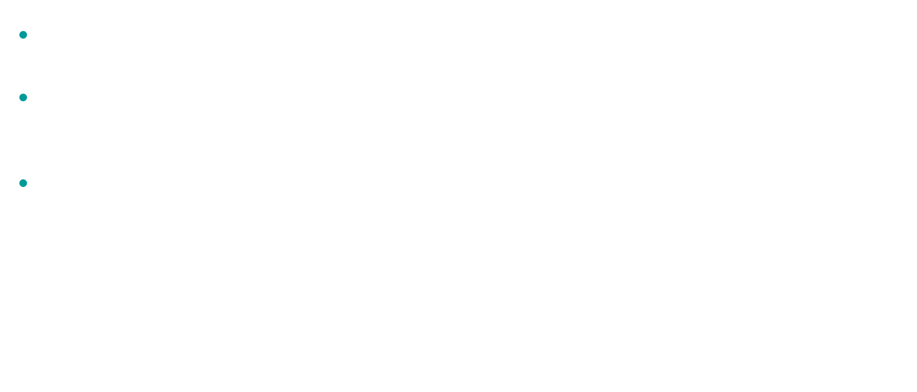
TCP Wrap Around Time
Wrap Around time = $\frac{Total Sequence No\left(2^{k}\right)}{Bandwidth (B)}$
Here we are assuming Sequence no field has k bits & Bandwidth is in Bytes/sec
For lifetime of a packet $l sec.$ minimum Sequence no required (in bits) = $l ∗B (\log_{2}{l∗B})$

Slide 41
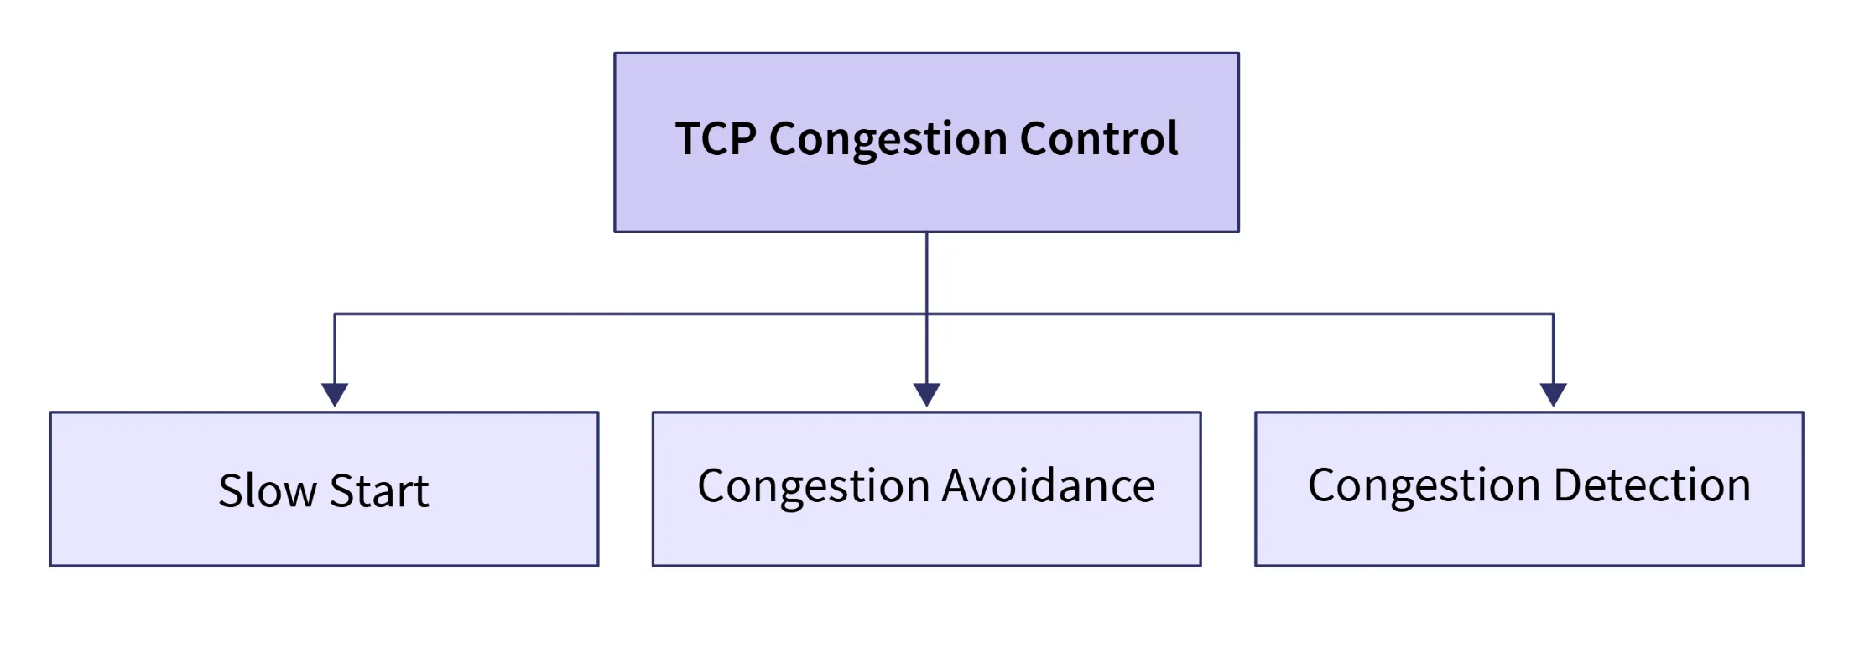
TCP Congestion Control

Slide 42
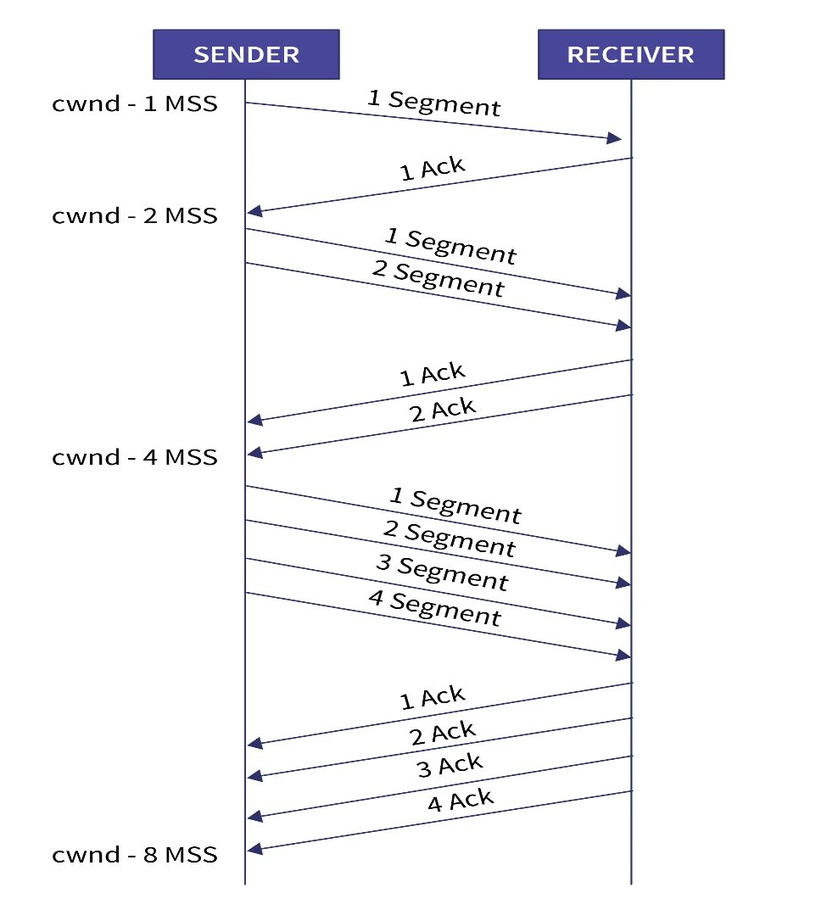
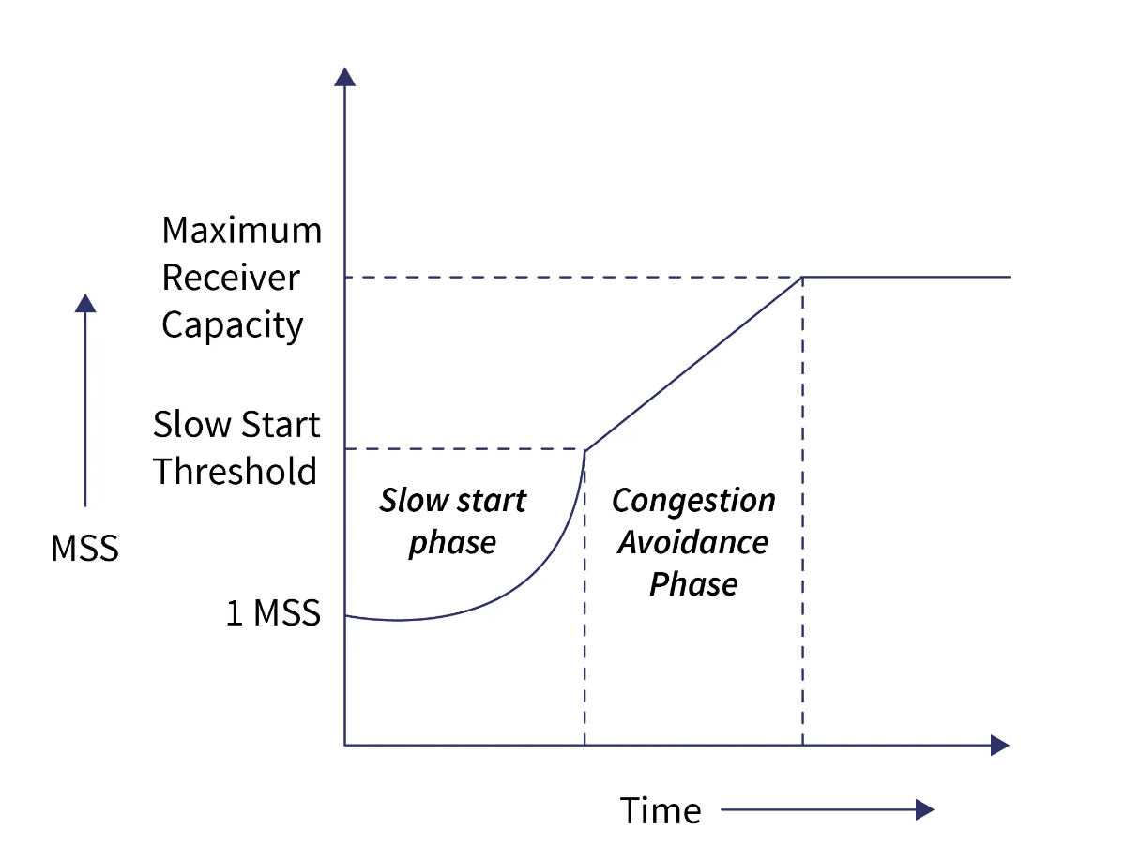
Congestion Control Phases

Slide 43
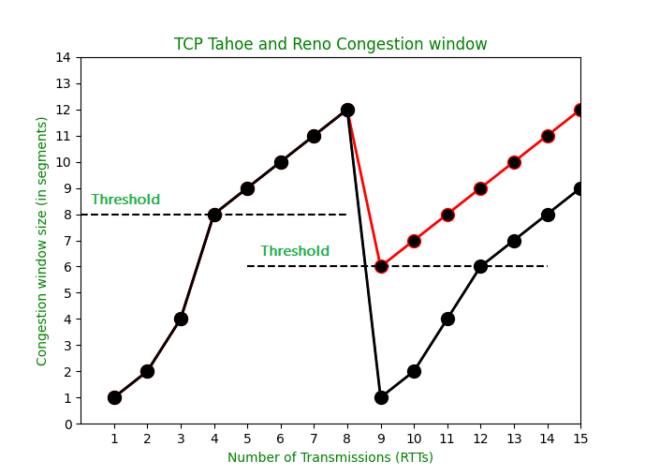
TCP Congestion Detection

Slide 44
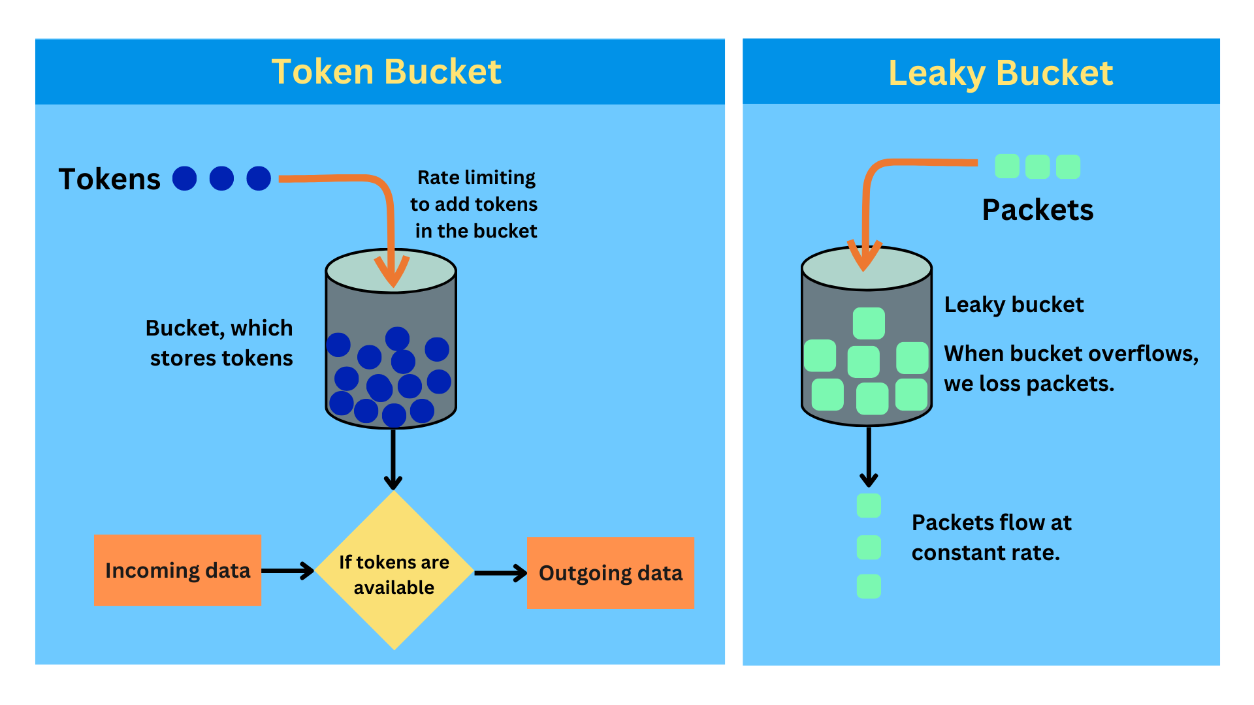
Congestion Control Algorithms

Slide 45
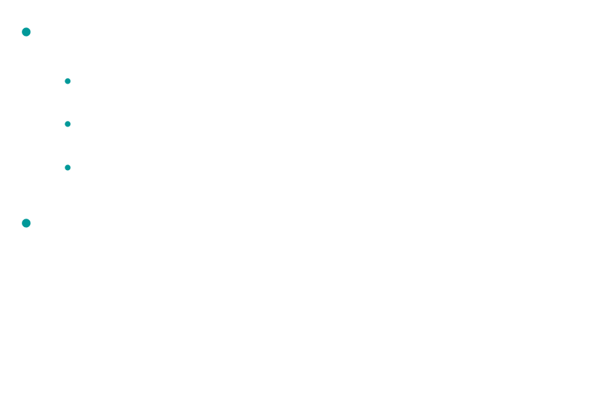
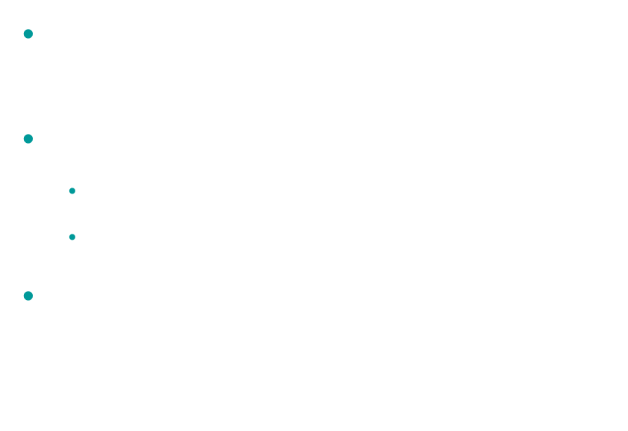
Congestion Control Algorithms
Leaky Bucket
Token Bucket
Output rate (constant): $R_{out}$ =$constant$
Condition:
Input rate ≤ $R_{out}$→ no packet loss
Input rate > $R_{out}$→ packets dropped
Queue constraint: $Queue size ≤ Bucket capacity$
Let,
r = token generation rate (tokens/sec)
b = bucket capacity (tokens)
t = time interval (sec)
Maximum data that can be sent in time t: $Data ≤ b + r∗t$

Slide 46
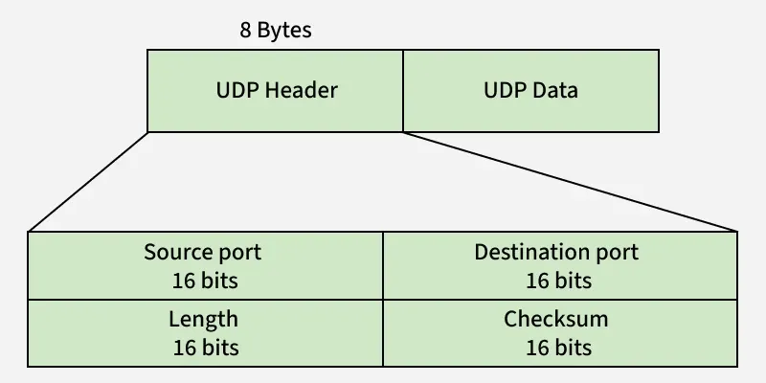
UDP Header

Slide 47
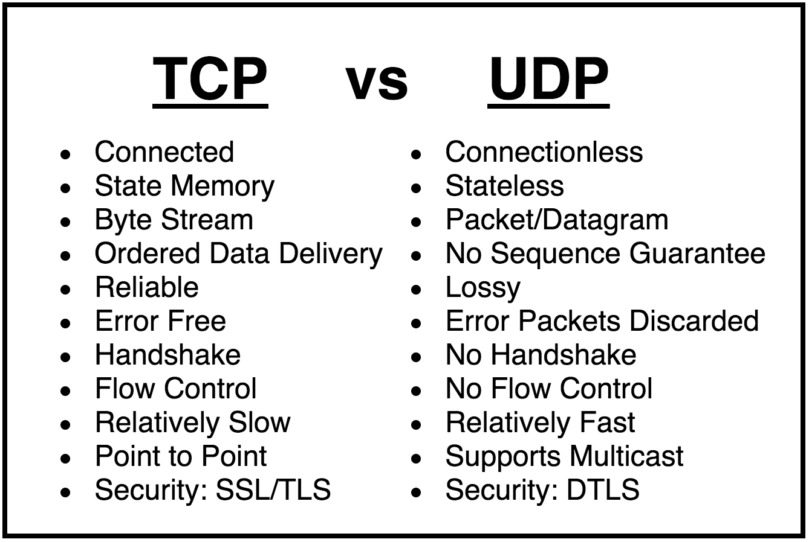
TCP vs UDP

Slide 48
Medium Access Control

Slide 49
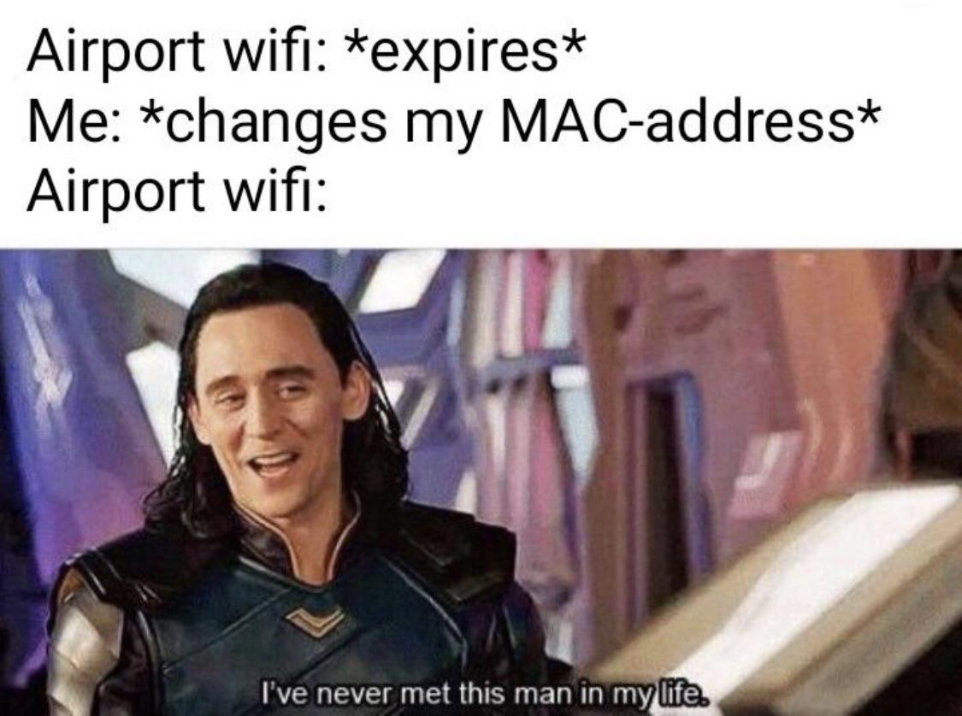
What’s Going On in the Medium Access Control Layer?

Slide 50
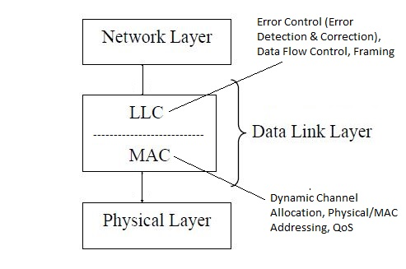
Where is the MAC Layer?

Slide 51
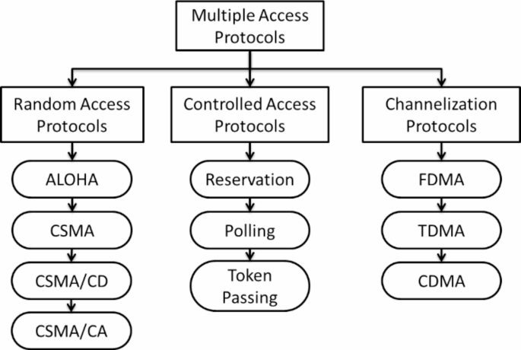
Multiple Access Protocols

Slide 52
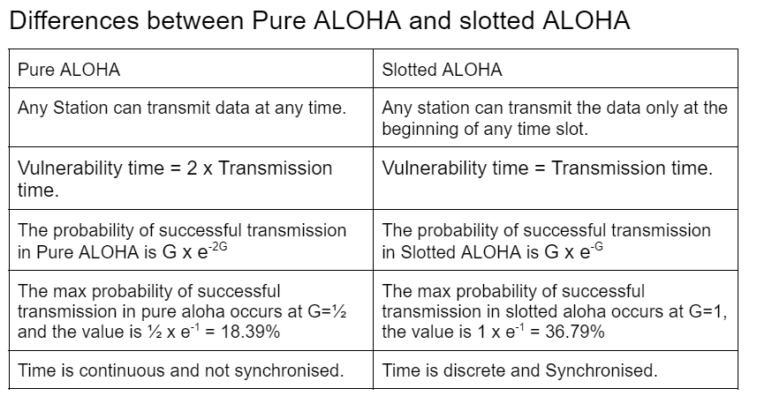
ALOHA

Slide 53
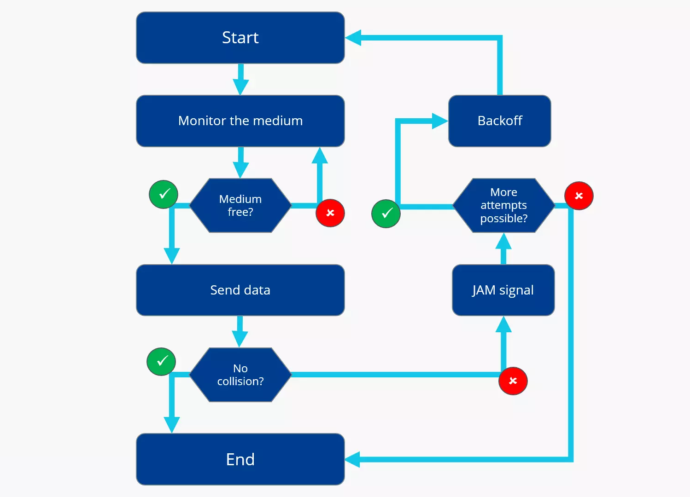
Ethernet: CSMA/CD

Slide 54
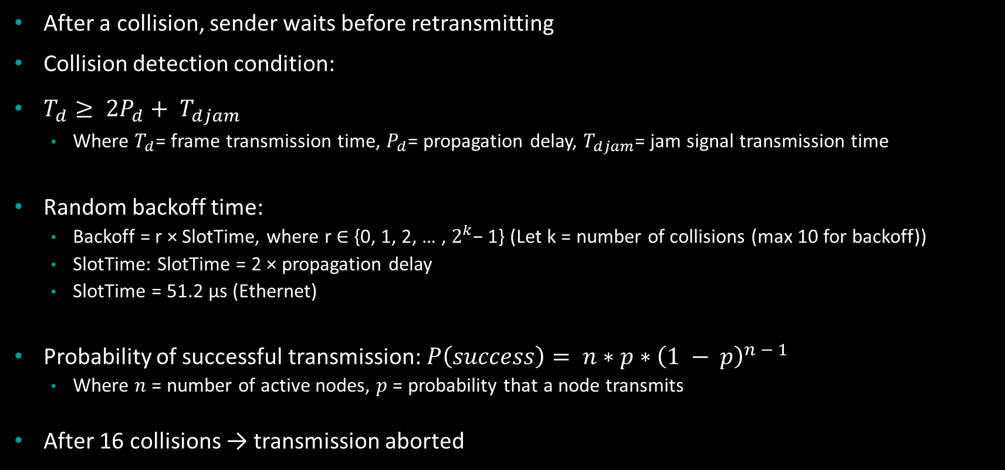
CSMA/CD Binary Exponential Backoff
After a collision, sender waits before retransmitting
Collision detection condition:
$T_{d}≥ 2P_{d}+ T_{djam}$
Where $T_{d}$= frame transmission time, $P_{d}$= propagation delay, $T_{djam}$= jam signal transmission time
Random backoff time:
Backoff = r × SlotTime, where r ∈ {0, 1, 2, … , $2^{k}$− 1} (Let k = number of collisions (max 10 for backoff))
SlotTime: SlotTime = 2 × propagation delay
SlotTime = 51.2 µs (Ethernet)
Probability of successful transmission: $P\left(success\right)= n∗p∗{\left(1 − p\right)}^{n − 1}$
Where $n$ = number of active nodes, $p$ = probability that a node transmits
After 16 collisions → transmission aborted

Slide 55
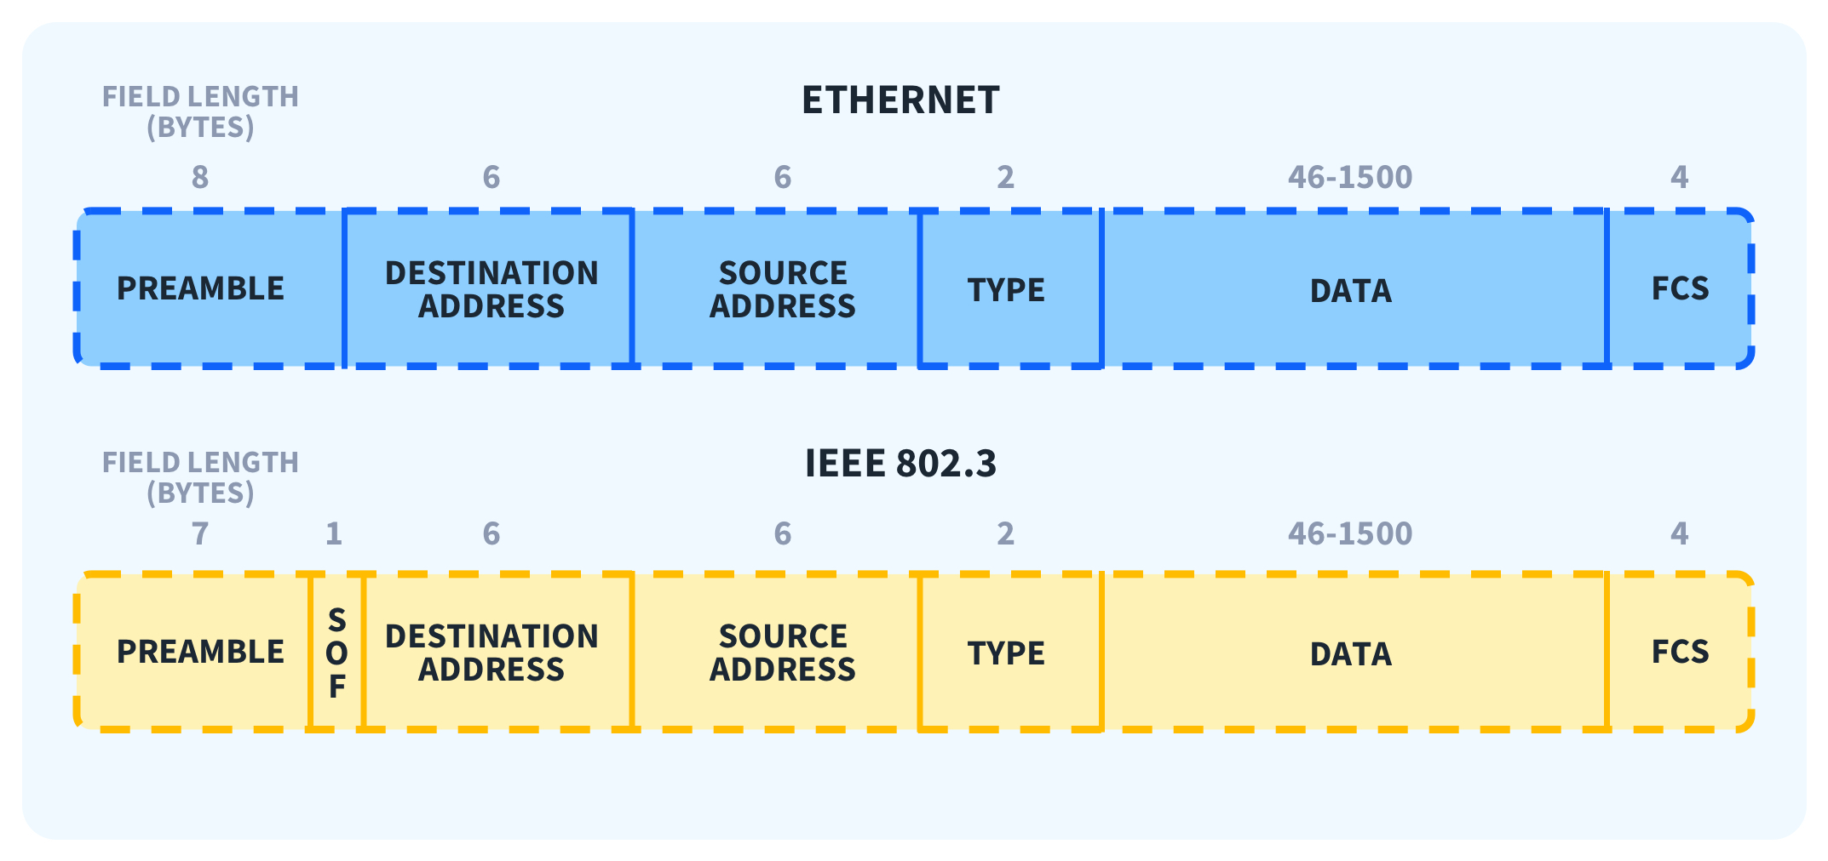
Ethernet Frame

Slide 56
Routing, Switching, IP Support Protocol

Slide 57
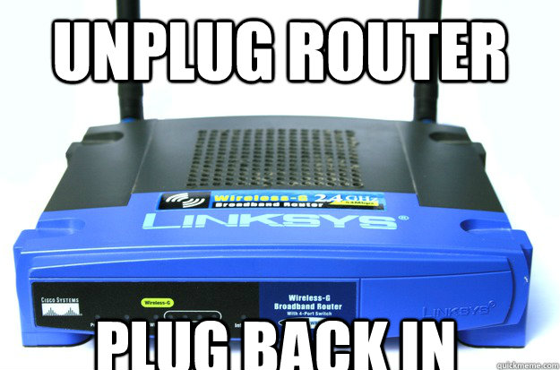
How Does a Packet Get Routed in a Network?

Slide 58
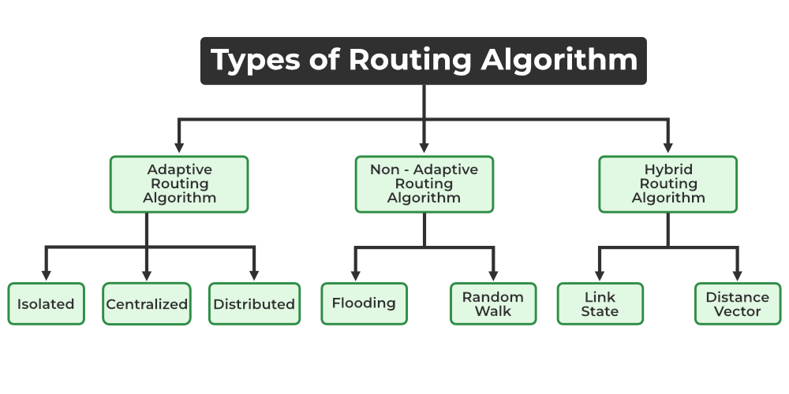
Routing Algorithms

Slide 59
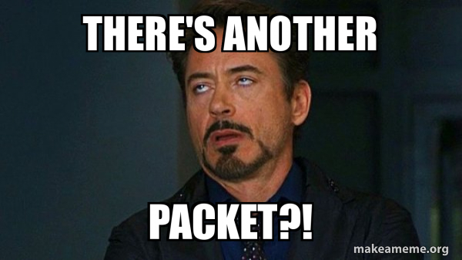
Flooding

Slide 60

Distance Vector Routing

Slide 61

Link State Routing

Slide 62

Distance Vector vs Link State Routing

Slide 63

Do Packets Really Hop Between Routers?

Slide 64

Switching Methods

Slide 65

Circuit Switching

Slide 66

Packet Switching

Slide 67

Circuit Switching vs Packet Switching

Slide 68

Datagram vs Virtual-Circuit Packet Switching

Slide 69

Message Switching

Slide 70

Does IP Need Supporting Protocols?

Slide 71

Network Layer Protocols

Slide 72

Address Resolution Protocol

Slide 73


Internet Control Message Protocol

Slide 74
Application Layer

Slide 75


Why Is This Layer Called the Application Layer?

Slide 76

How DNS works?

Slide 77


Types of DNS Lookup

Slide 78

How HTTP works?

Slide 79


Non-Persistent HTTP

Slide 80


Persistent HTTP

Slide 81

What Are SMTP, POP3, and IMAP?

Slide 82

How Email Works: SMTP, POP3 & IMAP?

Slide 83

How FTP Works?

Slide 84

How DHCP Works

Slide 85
At a Glance
Protocol | Purpose | Port No(s) | TCP / UDP | Stateful?
DNS | Name → IP resolution | 53 | UDP / TCP | ❌ No
HTTP | Web transfer | 80 | TCP | ❌ No
SMTP | Send email | 25 (Server → server) / 587 (client → server) | TCP | ✔ Yes
POP3 | Retrieve email | 110 | TCP | ✔ Yes
IMAP | Access email | 143 | TCP | ✔ Yes
FTP | File transfer | 21 (Control)/ 20 (Data) | TCP | ✔ Yes
DHCP | IP assignment | 67 (Server) / 68 (Client) | UDP | ✔ Yes

Slide 86
Some Interesting Facts
The first ARPANET message in 1969 was meant to be “LOGIN,” but the system crashed after “LO”—the Internet’s first word was an accident.
Designed during the Cold War, TCP/IP lets packets take multiple routes so the network survives even if parts are destroyed.

Slide 87
Some Interesting Facts
Ray Tomlinson used @ to separate user and machine names while testing ARPANET file transfers. That simple choice shaped email forever.
Early networks had too many collisions. Bob Metcalfe turned this flaw into a feature with CSMA/CD, letting Ethernet handle collisions instead of avoiding them.

Slide 88

Where to go next?
Computer Networking: A Top-Down Approach James Kurose, Keith Ross

Slide 89
“In theory, theory and practice are the same. In practice, they are not.” — Jan van de Snepscheut

